Slide 1

Digital Empowerment: Leveraging Technology to skill India's next generation

Slide 2
The Context: Why we want to do it?

Slide 3
We want to become a Developed Nation!
What are the key parameters to become a developed nation?

Slide 4
Per Capita Income (2023)
Developed countries generally have high GDP and GNI per capita. This indicates a high level of economic productivity and individual income.
High-Income Countries (Developed): GNI per capita of $13,845 or more.
Upper-Middle-Income Countries: GNI per capita between $4,046 and $13,845.
Lower-Middle-Income Countries: GNI per capita between $1,046 and $4,045.
Low-Income Countries: GNI per capita of $1,045 or less
USA - $76,000​
Germany - $52,000​
UK - $48,000​
Japan - $43,000​
Canada - $53,000​
China - $13,000
India Approximately $2,400​
*Per Capita Income data (2023) (Browntape)​
*World Bank Classification

Slide 5
Other Parameters
Human Development Index (HDI): a country’s average achievements in health (life expectancy), education (mean years of schooling), and standard of living (GNI per capita).
Infrastructure and Technological Advancements: a well-developed infrastructure, including transportation, telecommunications, utilities, and heavy investments in research and development
Health and Education: a high life expectancy and low infant mortality rates and heavy investment in education
Industrialization and Economic Structure: a diversified economy with a significant portion of their GDP coming from the industrial and service sectors rather than agriculture.
Quality of Life and Standard of Living: High standards of living in terms of housing, healthcare, education, and social services
Political Stability and Governance: Political stability, effective governance, rule of law, and low levels of corruption
Social and Environmental Sustainability: emphasis on social equity and environmental sustainability.

Slide 6
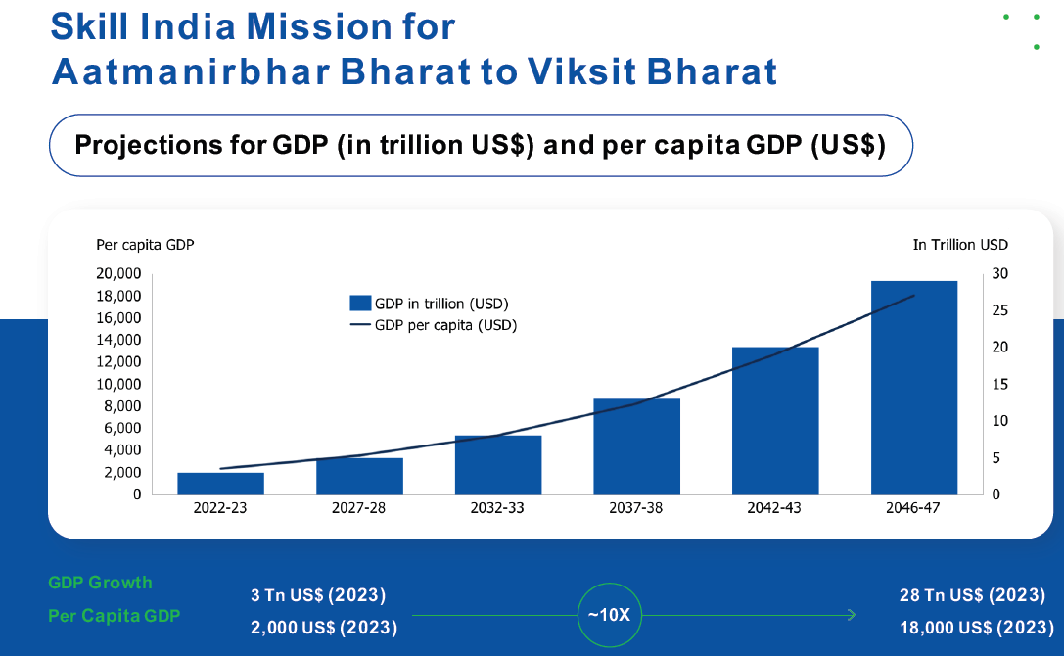
10 x growth
28 Trillion Economy
18,000 USD per capita

Slide 7
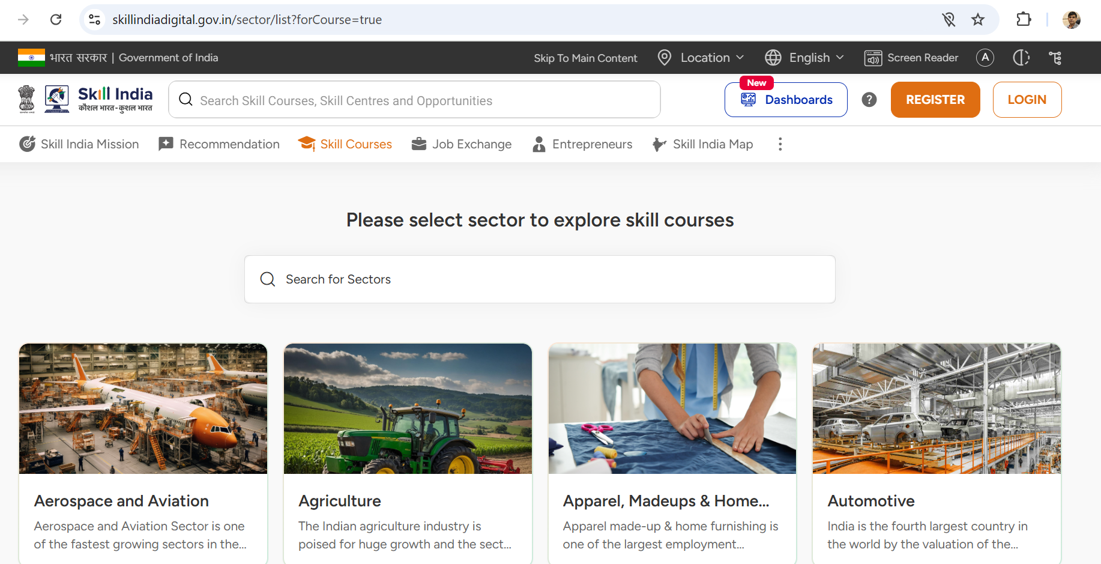
Availability of Digital Public Infrastructure for Skilling – NSDC’s SIDH
45% of GCCs operating in India – on path to become Innovation capital of the world

Slide 8
New Education Policy (NEP 2020) as an Enabler
Multiple entries and multiple exit (ME-ME) pathways in general & vocational education in between
Multi disciplinary and holistic education across sciences, social sciences, arts humanities & sports
Assignment, Accumulation, Storage & Transfer of credits in Academic Bank of Credits
Imaginative and flexible curricular structures, enabling creative mixture
Educational acceleration & Recognition of RPL (For e.g. diploma students entry to 2nd/3rd year of engineering)

Slide 9
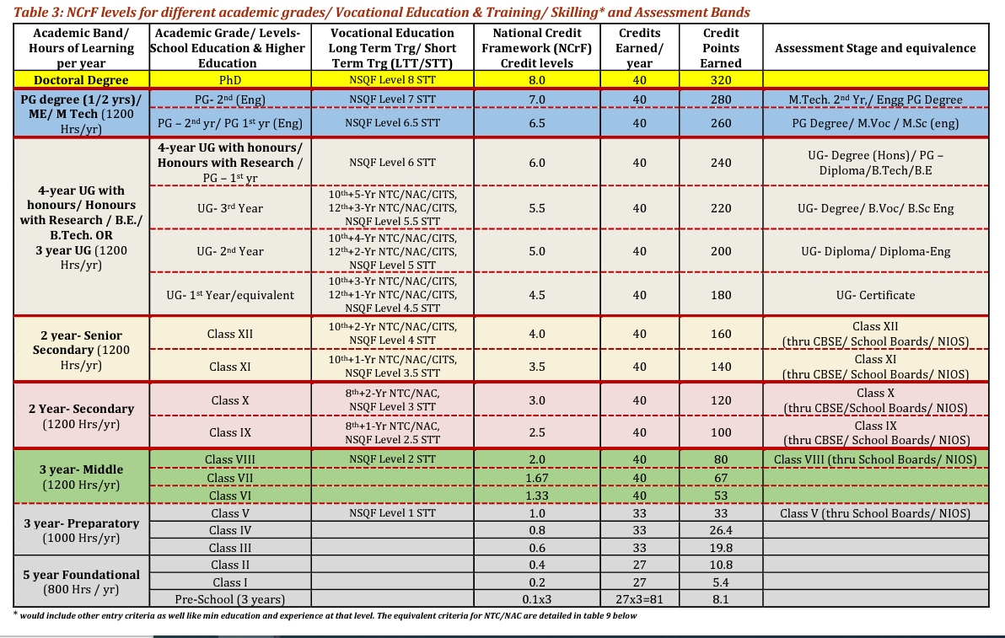

Slide 10
We want to be prepared for current and future job roles!
Where is the Future of Work headed? Job roles that will be in demand?

Slide 11
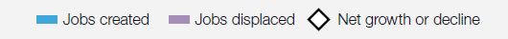
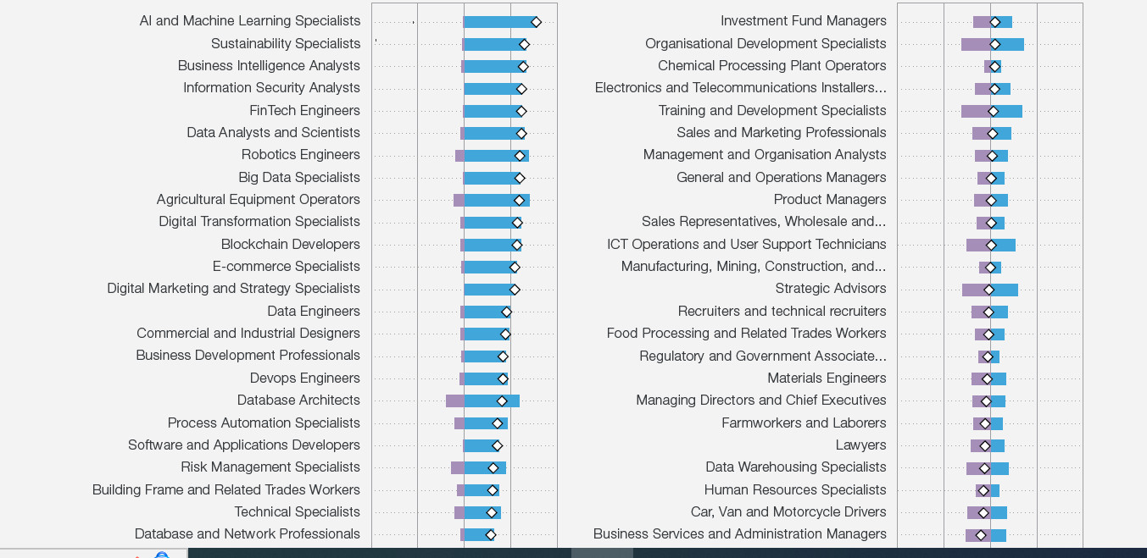
New Jobs and lost Jobs, 2023 -2027
AI and Machine Learning Specialists top the list of fast-growing jobs, followed by Sustainability Specialists and Business Intelligence Analysts. The majority of the fastest growing roles on the list are technology-related roles.
The majority of fastest declining roles are clerical or secretarial roles, with Bank Tellers and Related Clerks, Postal Service Clerks, and Cashiers and Ticket Clerks expected to decline fastest.

Slide 12
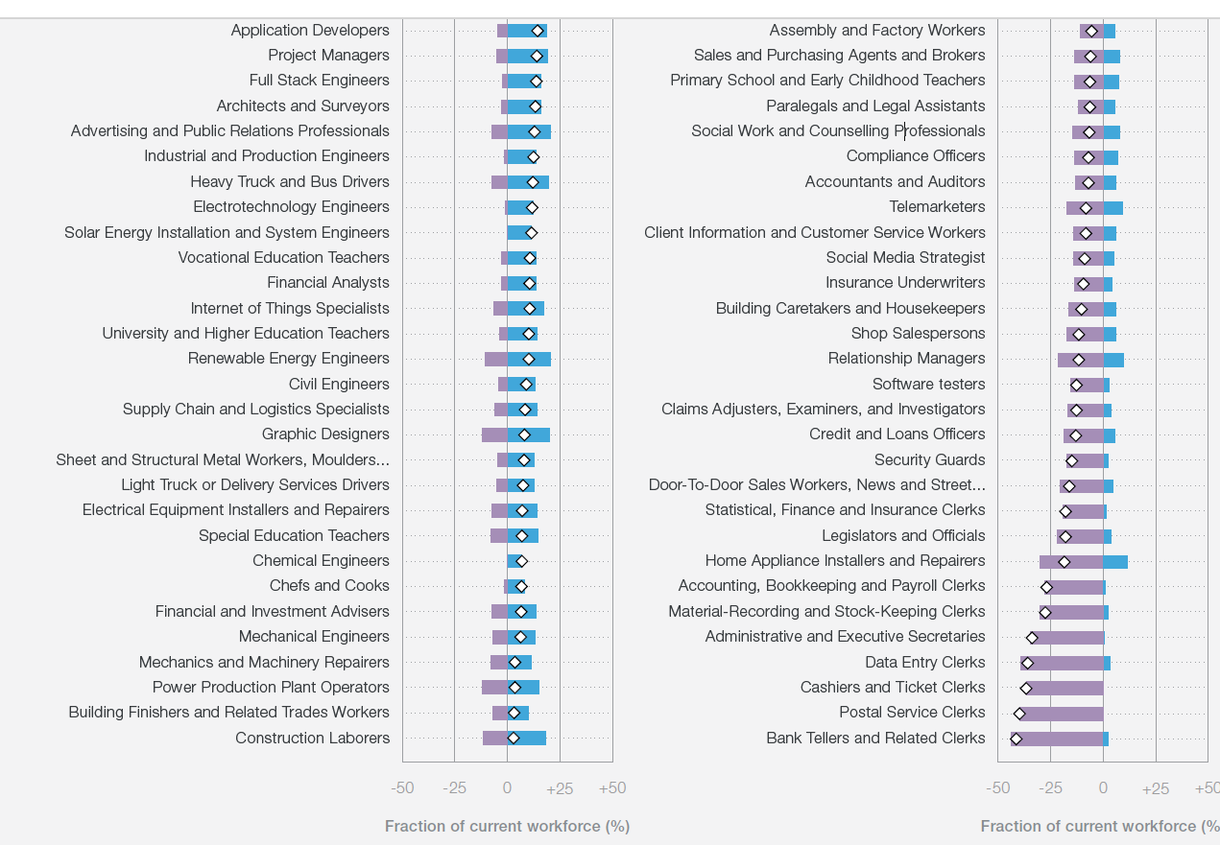
AI and Big data, Design and User Experience, and creative thinking as emergent areas.
AI and big data is the number three priority in company training strategies from now until 2027, and number one priority for companies with more than 50,000 employees.
AI and big data is also the most strongly prioritized skill in the
Insurance and Pensions;
Management,
Media,
Entertainment and Sports;
Information and Technology Services; Telecommunications;
Business Support and Premises Maintenance Services; and
Electronics industries.

Slide 13
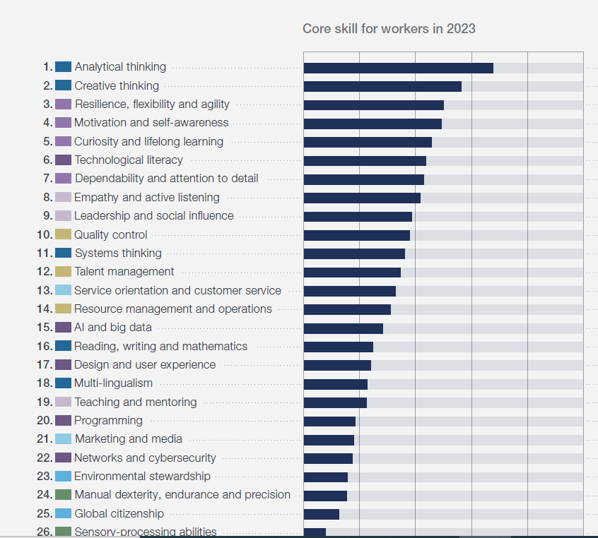
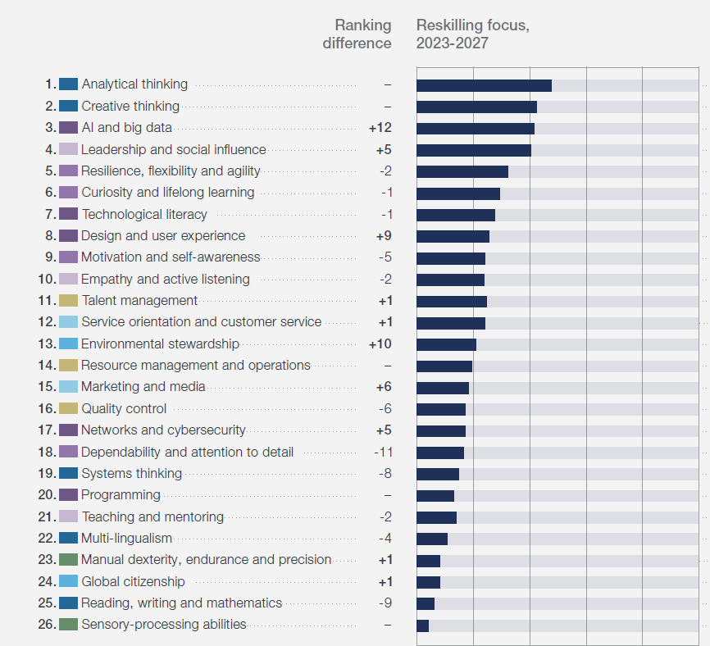
Horizontal Skills, 2023 -2027

Slide 14



Slide 15


Slide 16


Slide 17

Future of Work
Viksit Bharat
NEP & NCrF
LEARNERS | SKILL PROVIDERS | INSTITUTIONS | CORPORATES | GOVERNMENT
LEARNERS TO EARNERS

Slide 18
Leveraging Technology to skill India's next generation

Slide 19
What is SKILL?

Slide 20
The ability to use one's knowledge effectively and readily in execution or performance
Dexterity or coordination especially in the execution of learned physical tasks
* Ref. - Merriam Webster Dictionary

Slide 21
Sector Specific Software/ Tools
Horizontal Software Tools
Hardware based XR tools
Robots

Slide 22
Sector Specific Software Tools
Sector | Tools
Graphic Design | Adobe Photoshop, CorelDRAW, Adobe Illustrator, Affinity Designer, Blender, GIMP, Figma, Sketch, Inkscape, Canva
Video Editing | Adobe Premiere Pro, Final Cut Pro, DaVinci Resolve, After Effects, Cinema 4D, Sony Vegas, Avid Media Composer, Lightworks
Programming & Development | Visual Studio Code, PyCharm, Eclipse, Git, Jira, IntelliJ IDEA, NetBeans, Xcode, Sublime Text, GitHub Desktop
Data Analysis & Science | Tableau, Microsoft Power BI, RStudio, Jupyter Notebooks, MATLAB, Apache Hadoop, IBM SPSS, RapidMiner, SAS, KNIME
Audio & Music Production | Ableton Live, FL Studio, Logic Pro, Audacity, Pro Tools, GarageBand, Cubase, Reaper, Avid Sibelius, Studio One
Project Management | Trello, Asana, Monday.com, Microsoft Project, Basecamp, ClickUp, Wrike, Smartsheet, Notion, Zoho Projects
Learning Platforms | Coursera, Udemy, Khan Academy, LinkedIn Learning, edX, Skillshare, Pluralsight, FutureLearn, Codecademy, Udacity
3D Modeling & CAD | AutoCAD, SolidWorks, SketchUp, Fusion 360, Rhino, CATIA, TinkerCAD, FreeCAD, Onshape, ZBrush
Cybersecurity | Wireshark, Metasploit, Kali Linux, Nmap, Burp Suite, Nessus, Snort, OpenVAS, Aircrack-ng, OWASP ZAP, Splunk
Cloud Computing | AWS (Amazon Web Services), Microsoft Azure, Google Cloud, IBM Cloud, Oracle Cloud, DigitalOcean, Heroku, VMware, OpenShift
Database Management | MySQL, PostgreSQL, MongoDB, Microsoft SQL Server, Oracle Database, SQLite, Cassandra, Redis, CouchDB, MariaDB
Web Development | WordPress, Drupal, Joomla, Adobe Dreamweaver, Wix, Squarespace, Shopify, Webflow, Bootstrap, Angular, React
Artificial Intelligence | TensorFlow, Keras, PyTorch, OpenAI GPT, IBM Watson, Google AI Platform, H2O.ai, Microsoft Azure AI, Scikit-learn, OpenCV
Business & Finance Tools | QuickBooks, SAP, Oracle ERP, Microsoft Dynamics, Xero, FreshBooks, Zoho Books, Sage, Wave, Tally
Game Development | Unity, Unreal Engine, Godot, CryEngine, GameMaker Studio, Construct, RPG Maker, Blender (for 3D assets), Stencyl
Animation | Toon Boom Harmony, Moho (Anime Studio), Pencil2D, OpenToonz, Synfig, Dragonframe, Character Animator, Blender
UX/UI Design | Adobe XD, Figma, Sketch, InVision, Axure RP, Balsamiq, Marvel App, Framer, Zeplin, Origami Studio
Office & Productivity | Microsoft Office (Word, Excel, PowerPoint), Google Workspace (Docs, Sheets, Slides), Notion, Evernote, Zoho Docs, Slack
Virtualization | VMware Workstation, VirtualBox, Hyper-V, Parallels Desktop, Citrix Hypervisor, Red Hat Virtualization

Slide 23
Sector Specific Software Tools
Sector | Tools
Human Resources (HR) | BambooHR, Workday, ADP Workforce Now, Zenefits, Gusto, SAP SuccessFactors, Lever, Greenhouse, JazzHR, Paycom
Customer Relationship Management (CRM) | Salesforce, HubSpot, Zoho CRM, Microsoft Dynamics 365, Pipedrive, Freshworks CRM, Nimble, Insightly, Copper, SugarCRM
Digital Marketing | Google Analytics, SEMrush, Ahrefs, Moz, Hootsuite, Buffer, Mailchimp, HubSpot Marketing Hub, Canva, Sprout Social
E-commerce | Shopify, WooCommerce, Magento, BigCommerce, PrestaShop, OpenCart, Ecwid, Volusion, Squarespace Commerce, Wix Stores
Construction & Architecture | AutoCAD, Revit, ArchiCAD, SketchUp, Rhino, BIM 360, Bluebeam Revu, PlanGrid, Vectorworks, Tekla
Accounting & Finance | QuickBooks, Xero, FreshBooks, Wave, Zoho Books, Sage 50cloud, Tally, NetSuite, SAP, Kashoo
Supply Chain Management | SAP SCM, Oracle SCM Cloud, Manhattan Associates, Blue Yonder, Infor SCM, Coupa, HighJump, Kinaxis, E2Open
Healthcare | Epic Systems, Cerner, Allscripts, eClinicalWorks, Athenahealth, Meditech, Kareo, Practice Fusion, SimplePractice
Legal Practice | Clio, MyCase, Rocket Matter, PracticePanther, Bill4Time, Zola Suite, Smokeball, TimeSolv, CosmoLex, LawPay
Content Management Systems (CMS) | WordPress, Drupal, Joomla, Sitecore, TYPO3, Contentful, Adobe Experience Manager, Ghost, Squarespace, Umbraco
Data Warehousing & ETL | Apache Hadoop, Amazon Redshift, Snowflake, Talend, Informatica, Microsoft SQL Server Integration Services (SSIS), Fivetran, Matillion
Logistics & Transportation | SAP TMS, Oracle Transportation Management, Descartes, JDA TMS, Manhattan TMS, MercuryGate, 3Gtms, FreightPOP
Energy & Utilities | GE Digital, OSIsoft PI System, OpenUtilities, SAP IS-U, Siemens EnergyIP, Honeywell Forge, Oracle Utilities, ABB Ability
Real Estate | Zillow Premier Agent, Buildium, AppFolio, Propertyware, CoStar, RealPage, Yardi, Reonomy, LoopNet, Dotloop
Education & Learning Management Systems (LMS) | Blackboard, Moodle, Google Classroom, Canvas, Schoology, TalentLMS, SAP Litmos, Docebo, Edmodo, Absorb LMS
Enterprise Resource Planning (ERP) | SAP ERP, Oracle ERP Cloud, Microsoft Dynamics 365, NetSuite ERP, Odoo, Sage Intacct, Epicor ERP, Infor ERP
Retail Management | Lightspeed, Vend, Square for Retail, Shopify POS, NCR Silver, Retail Pro, Erply, NetSuite POS, Revel Systems, Clover
Event Management | Eventbrite, Cvent, Bizzabo, Whova, Hopin, Splash, Ticketmaster, RegFox, Attendify, EventMobi
Hospitality Management | Oracle Hospitality, Cloudbeds, Hotelogix, RMS Cloud, RoomRaccoon, Mews, StayNTouch, WebRezPro, Infor Hospitality
Manufacturing | SAP Manufacturing, Siemens PLM, Autodesk Fusion 360, Epicor Manufacturing, Plex, DELMIAworks, Fishbowl, E2 Shop
Nonprofit Management | Blackbaud, DonorPerfect, Bloomerang, NeonCRM, Kindful, Salsa Labs, Givebutter, Funraise, CharityEngine, Keela
Sales | Salesforce Sales Cloud, HubSpot Sales Hub, Pipedrive, Zoho CRM, Microsoft Dynamics 365 Sales, Freshsales, Outreach, Copper
Mobile App Development | Android Studio, Xcode, Flutter, React Native, Ionic, Xamarin, Apache Cordova, Swift, Kotlin, Firebase

Slide 24
Horizontal Software Tools
Chatbots and Virtual Coaches: real-time coaching and feedback AI-driven tool, making learning interactive and adaptive – Chatgpt, Synthetica, HeyGen
AI-powered Learning Management Systems (LMS), Gamified Learning Platforms, Skill Assessment Tools - Personalized delivery- Disco, Coursera, LinkedIn Learning, Pluralsight etc.
Automated Content Creation and Delivery: AI to create personalized, interactive video lessons - Synthesia
Various other AI powered tools - Grammarly, Duolingo, Khan Academy, Quizlet, Chegg Study, Socratic by Google, Notion, Wolfram Alpha, Mendeley, RefMe etc.

Slide 25
Hardware Based XR tools: AR- MR - VR
Aspect | AR (Augmented Reality) | MR (Mixed Reality) | VR (Virtual Reality)
Environment | Real world with digital overlays | Blend of real and virtual worlds interacting | Fully virtual environment
Interaction | Limited interaction with digital objects | High interactivity between real and virtual objects | Fully immersive interaction within a virtual world
Hardware | Smartphone, tablet, AR glasses | Advanced headsets like Microsoft HoloLens, Magic Leap | VR headsets like Oculus Quest, HTC Vive, PS VR
Key Technologies | GPS, camera, AR SDKs (e.g., ARKit, ARCore) | Spatial mapping, AI for real-time interaction | 3D modeling, motion tracking, haptic feedback
Examples | - Pokémon GO: Overlaying virtual creatures on real-world locations - IKEA Place: Visualizing furniture in rooms using AR apps | - Microsoft HoloLens: Engineers designing and interacting with 3D models - Medical surgery simulations combining real anatomy with virtual overlays | - Beat Saber: Immersive VR gaming experience - VR Training Simulators: Pilots and surgeons practicing in virtual environments
Use Cases | Retail, gaming, navigation, education | Industrial training, healthcare, design visualization | Gaming, therapy, education, virtual tourism
Immersion Level | Low - enhances real-world view | Medium - interaction between real and virtual elements | High - complete detachment from the real world

Slide 26
Robots
Autonomous and AI-Powered Robots (2010s–Present): Robots with AI and machine learning capabilities, enabling decision-making and adaptation.
Examples:
Boston Dynamics' Robots: Advanced robots like Spot (quadruped) and Atlas (humanoid).
Sophia (2016): A humanoid robot developed by Hanson Robotics with conversational abilities.
Collaborative and Swarm Robots (Emerging Trends): Robots designed to work with humans or in coordinated groups.
Examples:
Cobots: Collaborative robots like Universal Robots' UR series used alongside humans in factories.
Swarm Robotics: Drones or micro-robots working in synchronized clusters for tasks like search and rescue.
Early Mechanical Automata (Pre-20th Century)
Industrial Robots (1940s–1960s): Description:
Programmable Robots (1970s–1980s): Robots with basic programming capabilities that could perform a variety of tasks.
Mobile and Service Robots (1990s–2000s): Robots capable of mobility and interactive service, expanding beyond industrial applications. Auto Vaccum cleaner etc.
Future
Self-replicating Robots: Capable of creating copies of themselves for exploration or manufacturing.
Soft Robotics: Inspired by biological organisms, these robots are flexible and adaptable.
Artificial General Intelligence (AGI): Robots with human-level understanding and reasoning.

Slide 27
Thanks

